Slide 1
WHITEBOARD
Like Blackboard, but for a student project
Brian VALERA
Monico Lara Jr.
Juan Garcia
Miguel eljuri
Miguel mojica

Slide 2
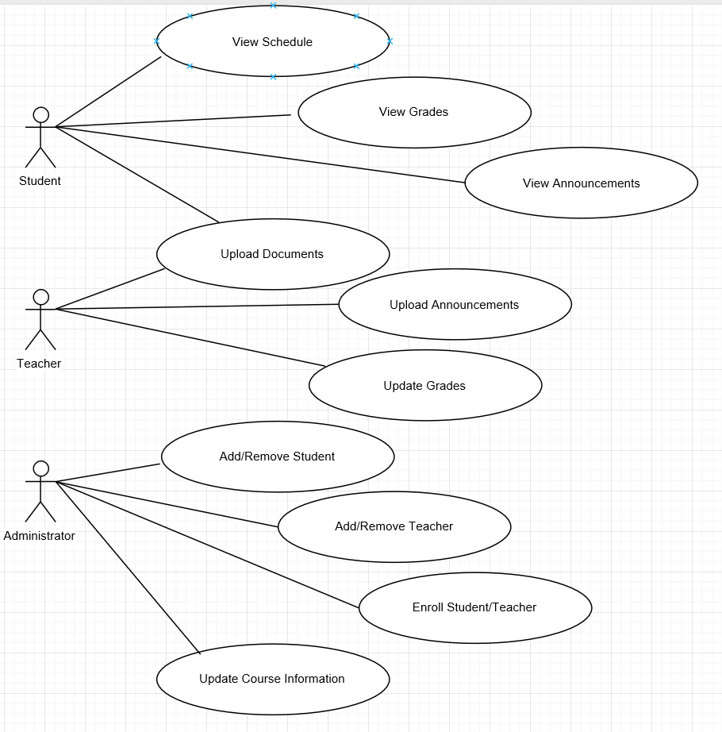
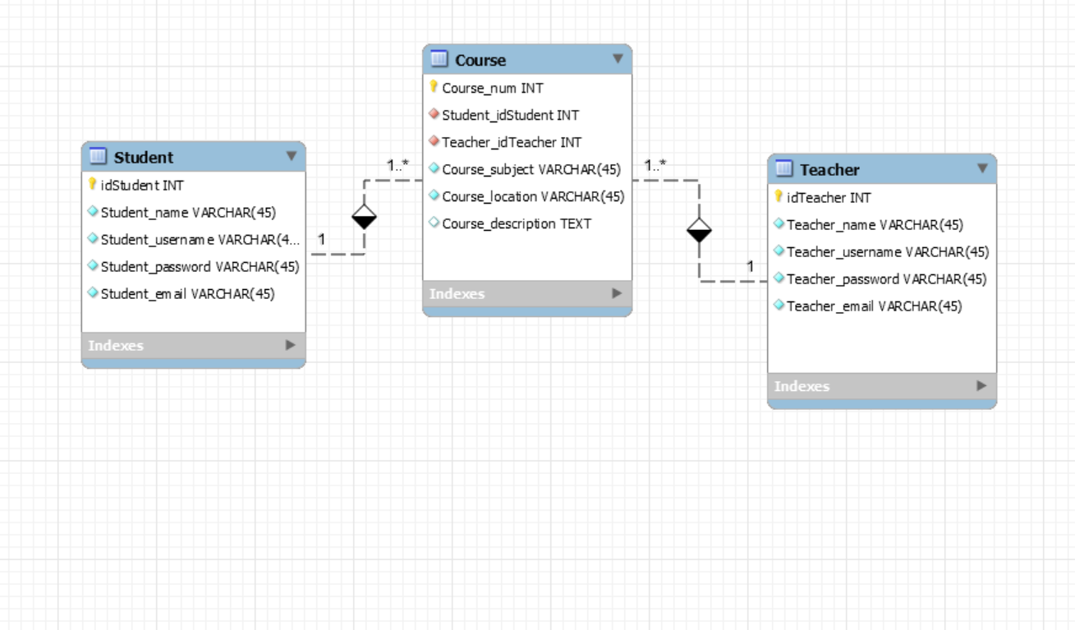
UML USE CASE & ER DIAGRAM

Slide 3
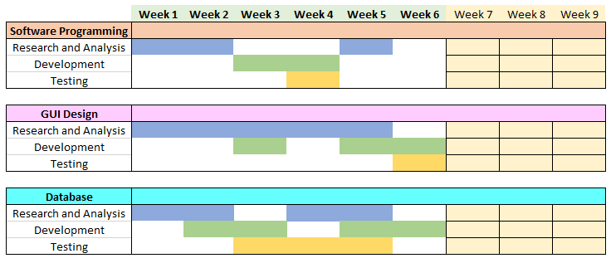
ANALYSIS WORKFLOW

Slide 4
TOOLS
Using Visual Studio for development of the main code in C++.
Qt was attempted for GUI, but then changed to Visual Basic in favor of developer accessibility
MySQL used for database development
Photoshop for GUI graphics

Slide 5
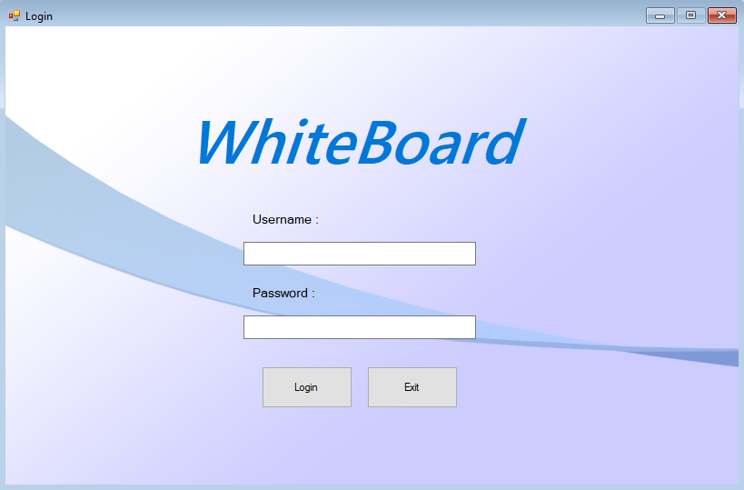
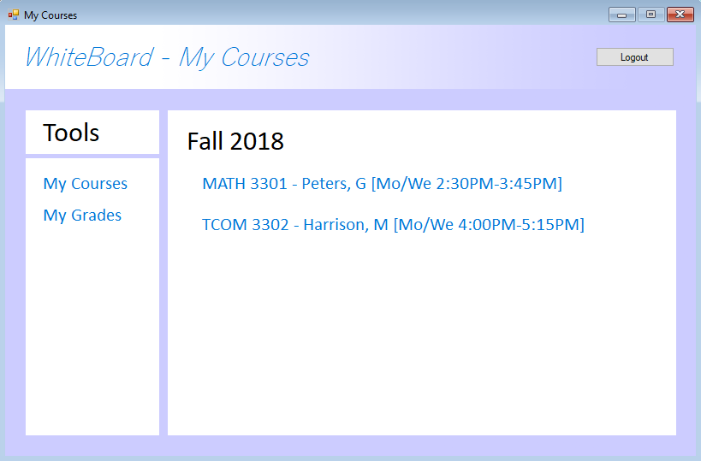
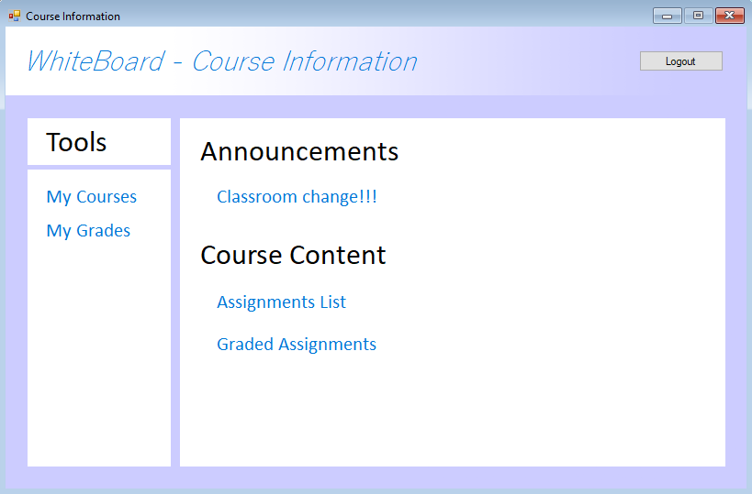
Future Plan
Combining
Separate
Work

